Slide 1
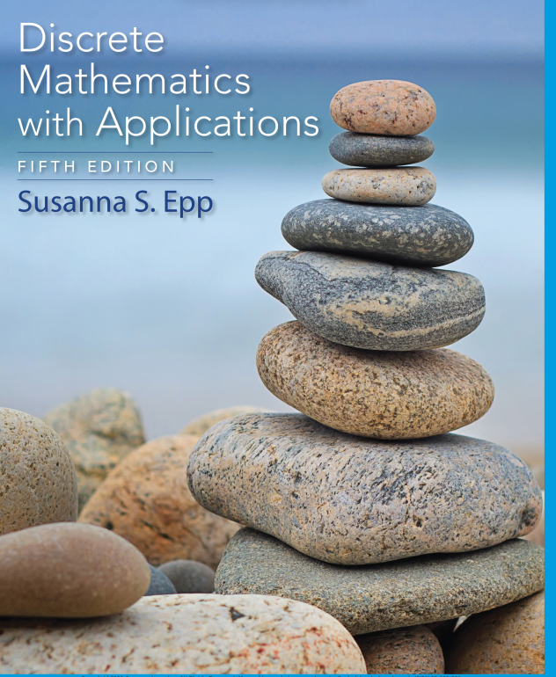
Chapter 1
Database Systems

Slide 2

Faculty of Computer Science
UFCFFS-30-1– Foundations of Computing: REGULAR EXPRESSIONS AND FINITE-STATE AUTOMATA
Instructor: Duc Minh Vu
3/25/2024
Data Structures and Algorithms in Python
2

Slide 3
Learning Objectives
Formal Languages and Regular Expressions
Finite-State Automata
Simplifying Finite-State Automata

Slide 4
Reading
Chapter 12 - Discrete Mathematics with Applications 5th Edition (Susanna’s Book)
Chapter 13 – Discrete Mathematics and Its Applications 7th Edition (Kenneth Rosen’s book)

Slide 5
Formal Languages and Regular Expressions

Slide 6
12.1 Formal Languages and Regular Expressions
An English sentence can be regarded as a string of words, and an English word can be regarded as a string of letters
Computer languages are similar to English in that certain strings of characters are legitimate words of the language and certain strings of words can be put together according to certain rules to form syntactically correct programs
A compiler for a computer language analyzes the stream of characters in a program—first to recognize individual word and sentence units, then to analyze the syntax, or grammar, of the sentences, and finally to translate the sentences into machine code.

Slide 7
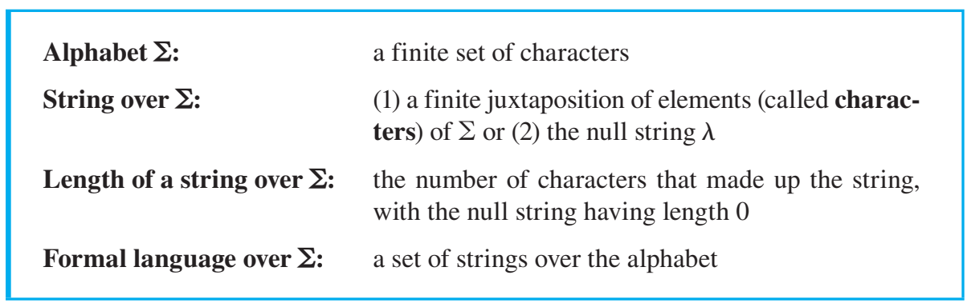
Formal Languages and Regular Expressions
Note A Greek sigma is the traditional symbol used to denote an alphabet in a formal language. It is smaller than the Greek sigma used for a summation

Slide 8
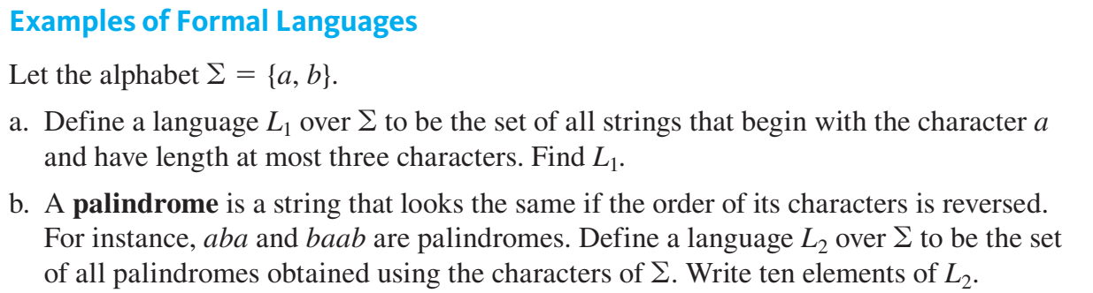
Example 12.1.1 - Examples of Formal Languages

Slide 9
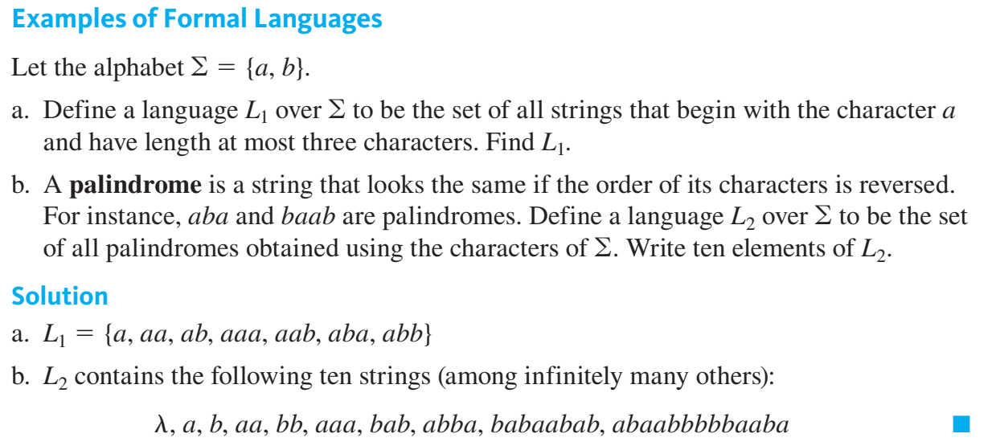

Slide 10
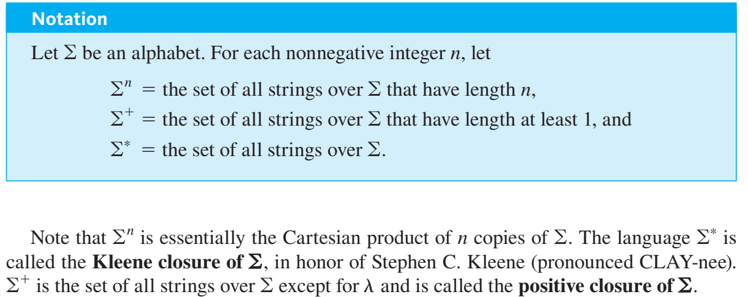

Slide 11
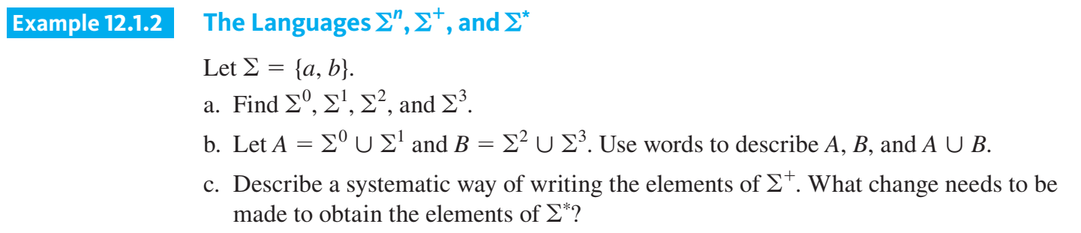

Slide 12
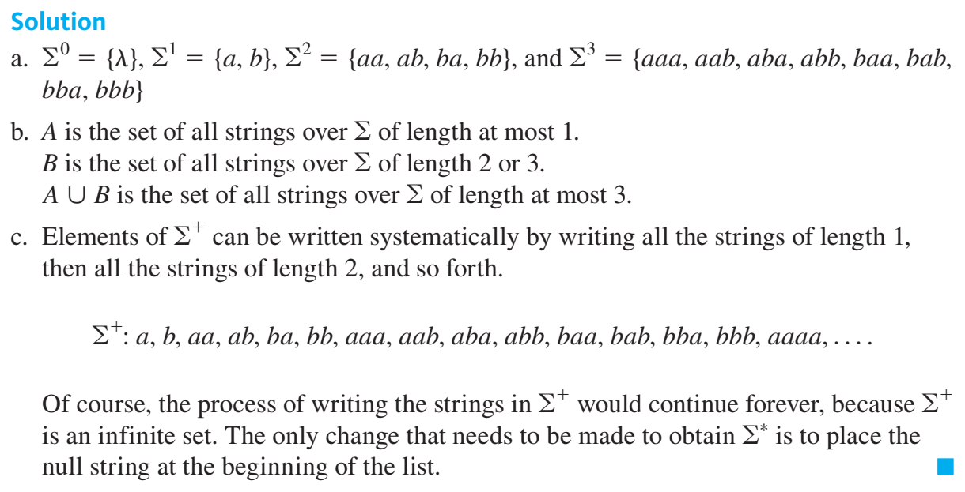

Slide 13
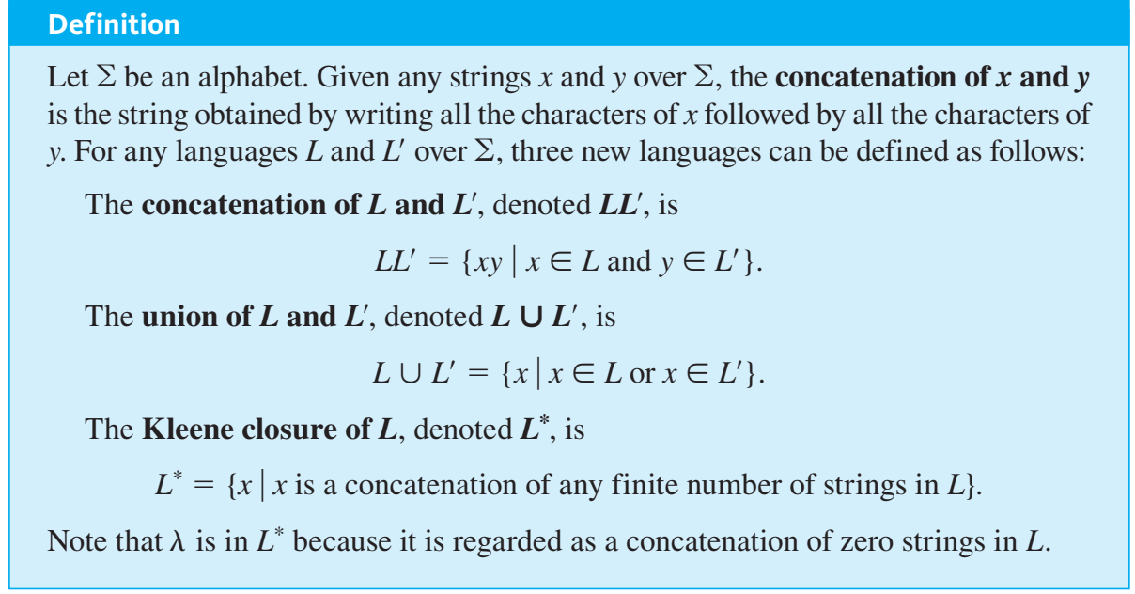

Slide 14
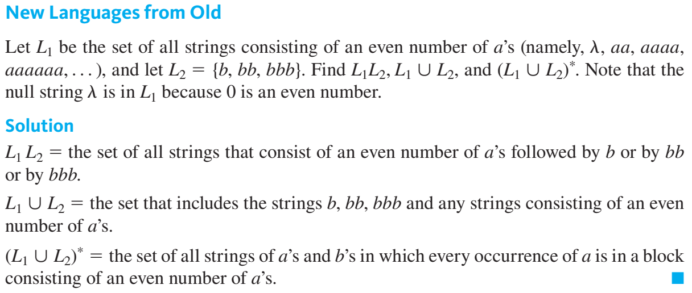

Slide 15
The Language Defined by a Regular Expression

Slide 16
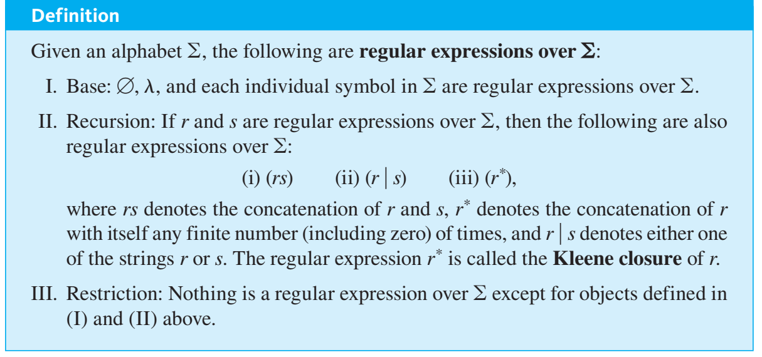

Slide 17
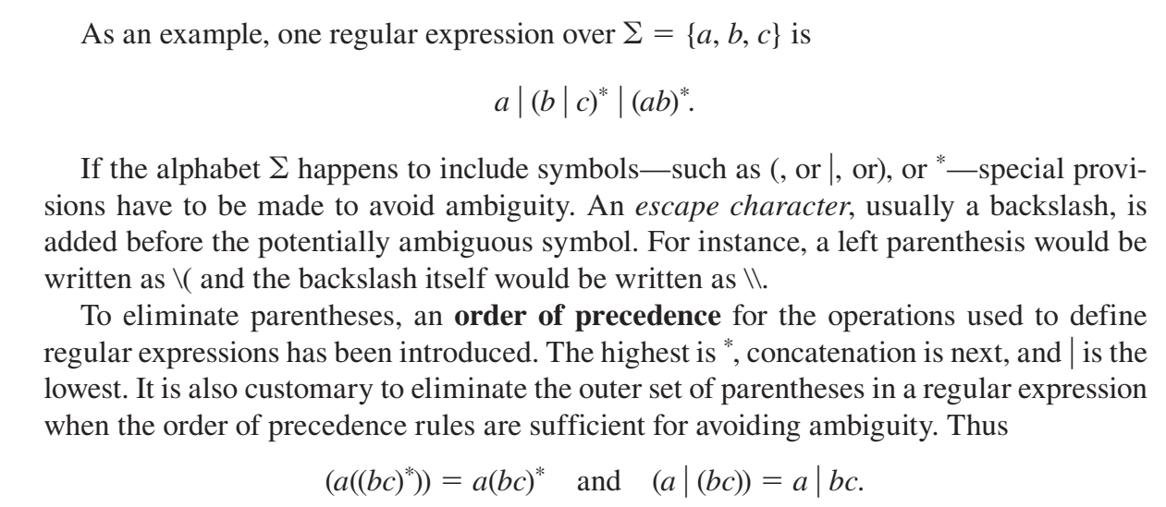

Slide 18
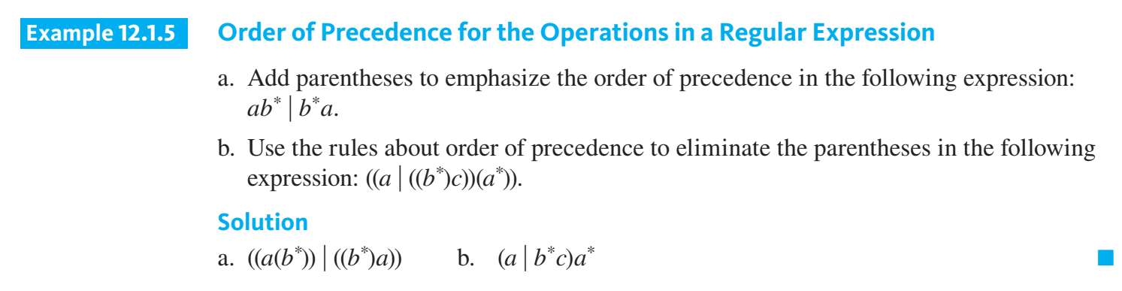

Slide 19
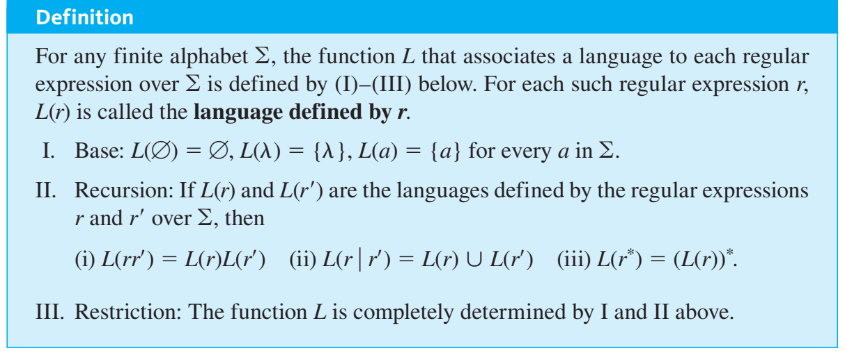

Slide 20
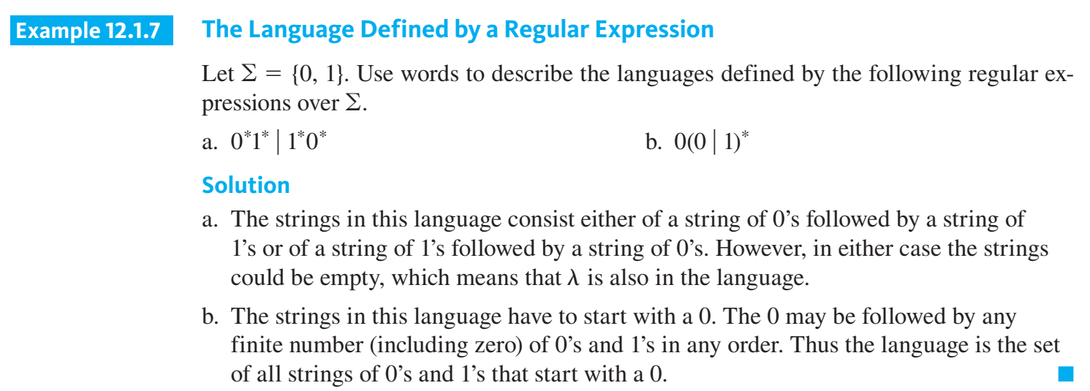

Slide 21
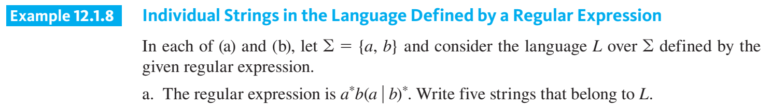
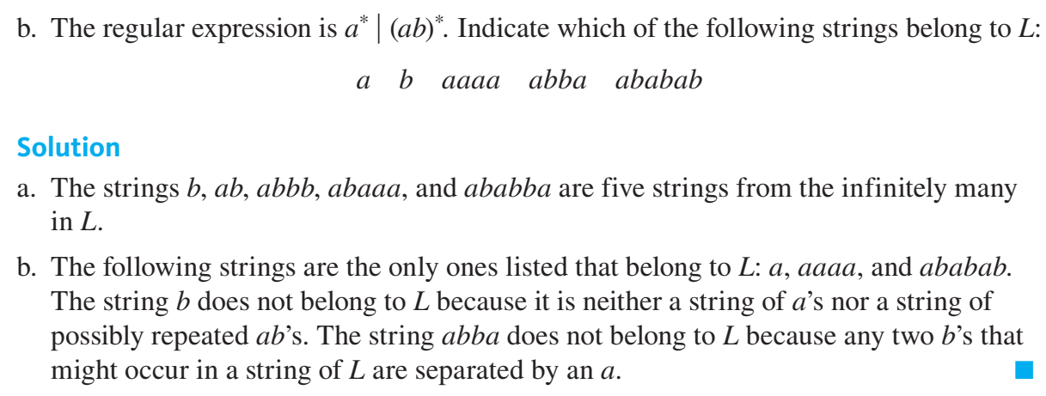

Slide 22
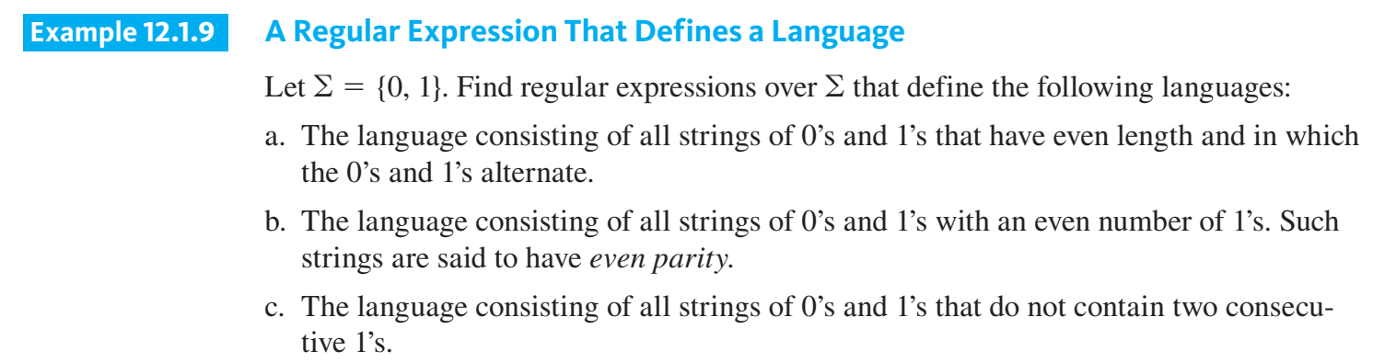

Slide 23
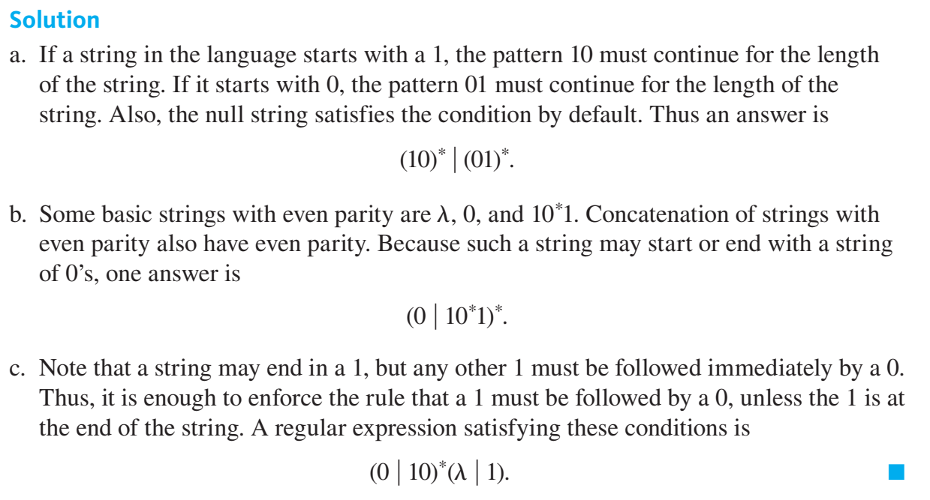

Slide 24
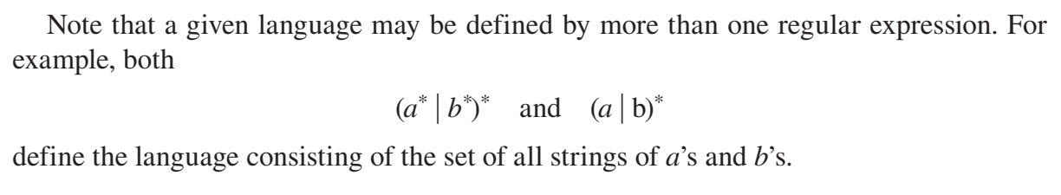

Slide 25
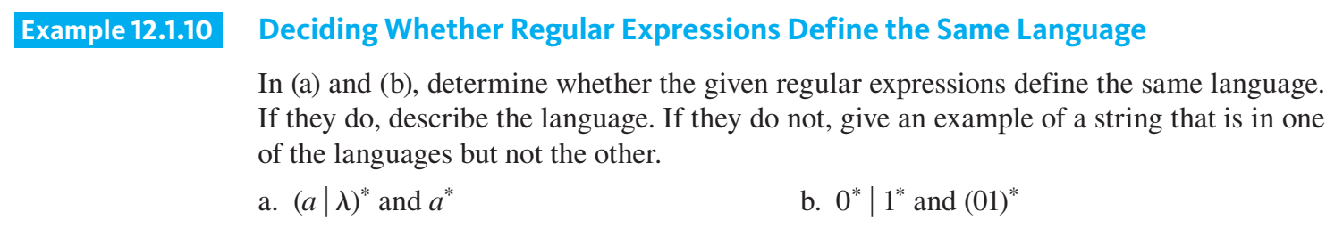
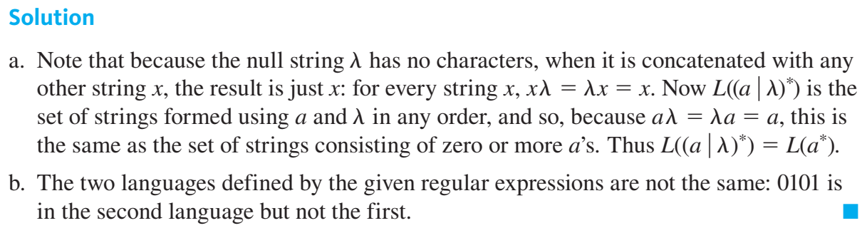

Slide 26
Practical Uses of Regular Expressions (option)

Slide 27
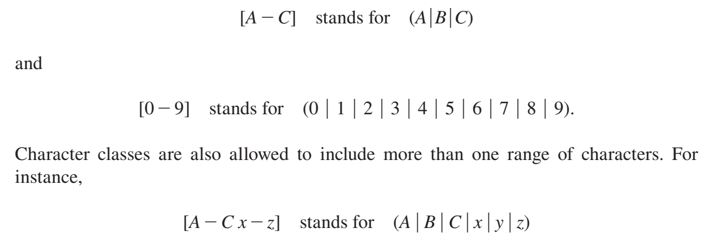

Slide 28
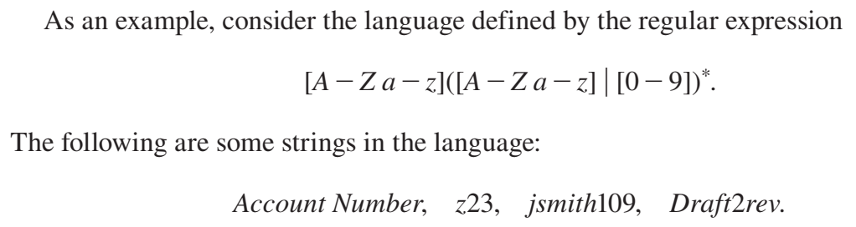

Slide 29
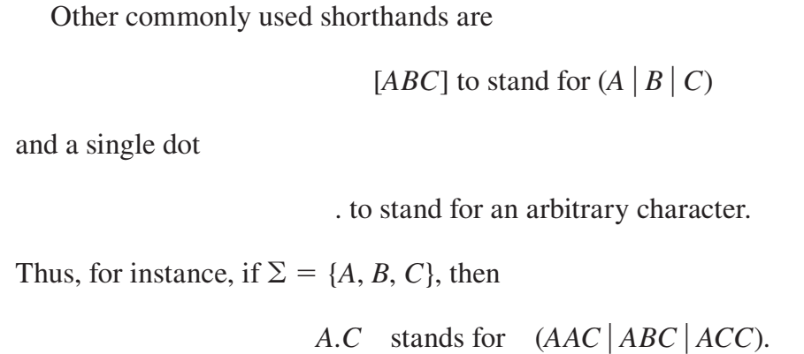

Slide 30
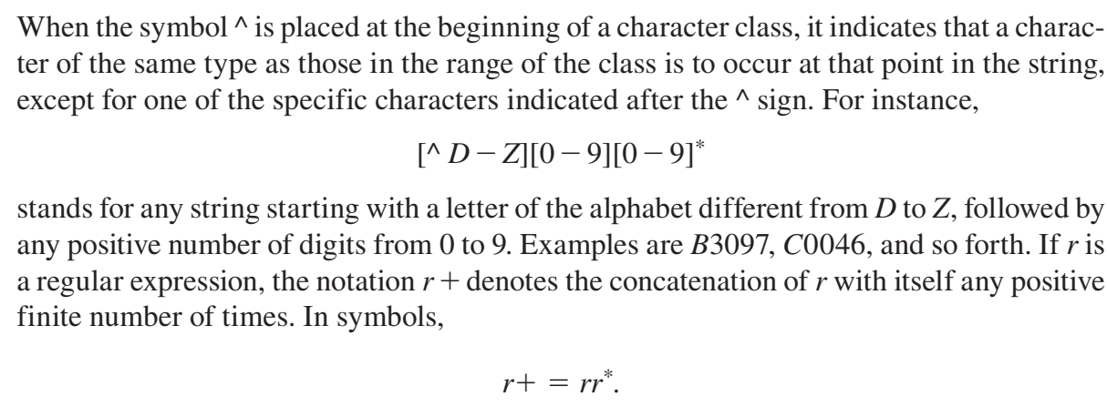

Slide 31
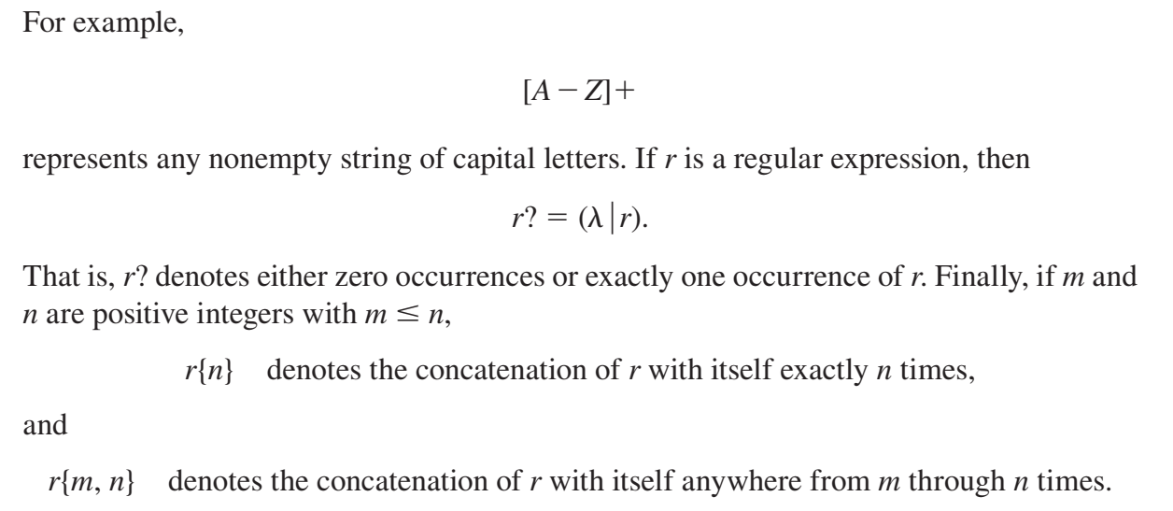

Slide 32
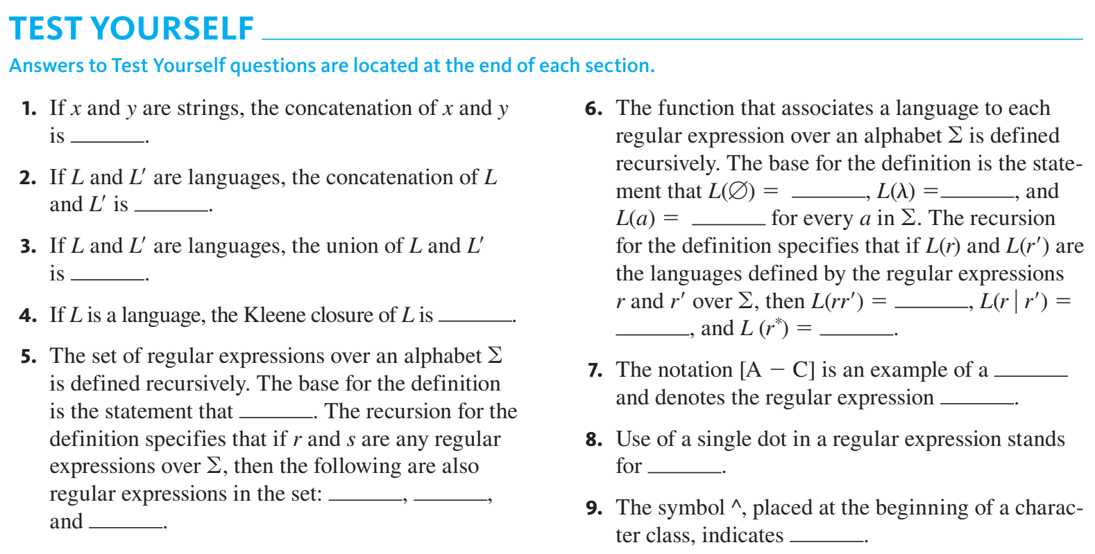

Slide 33
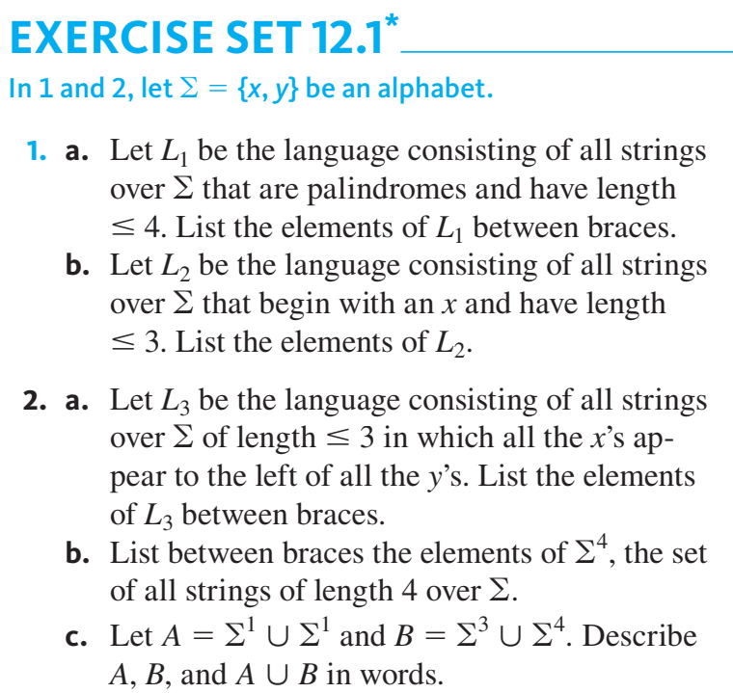
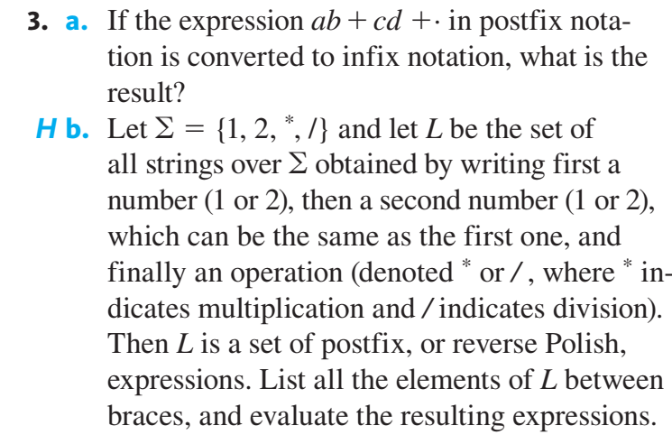

Slide 34
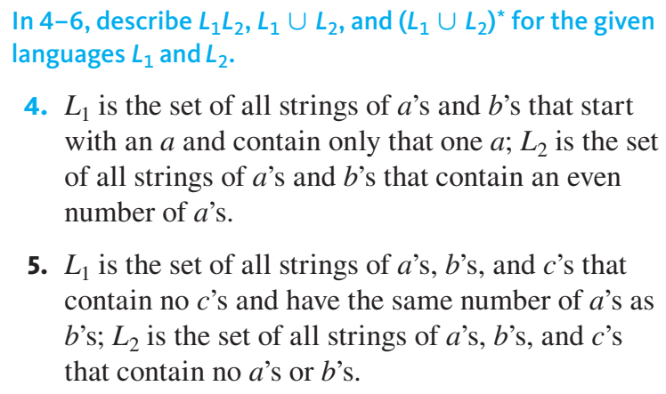
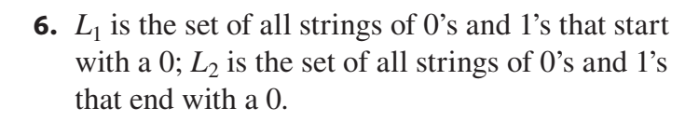

Slide 35
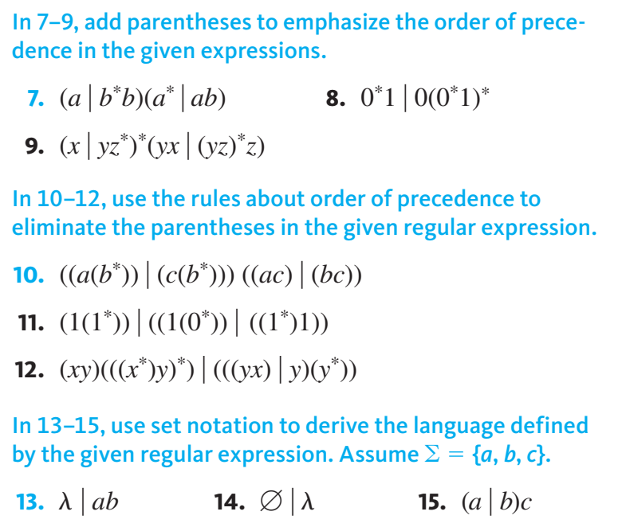

Slide 36
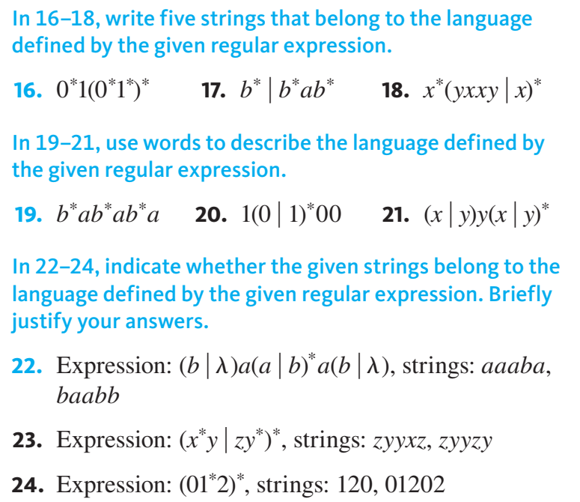

Slide 37
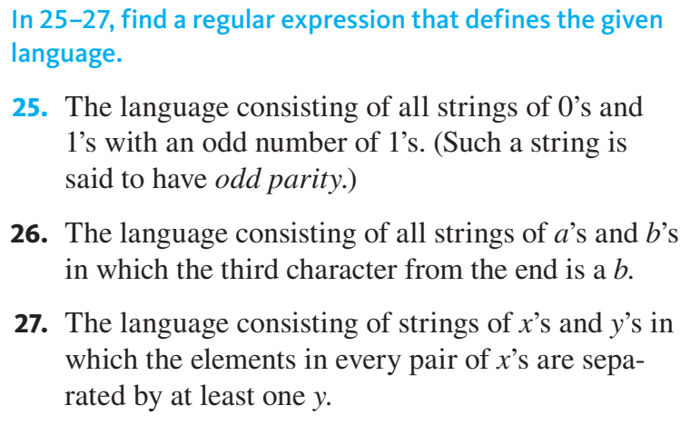

Slide 38
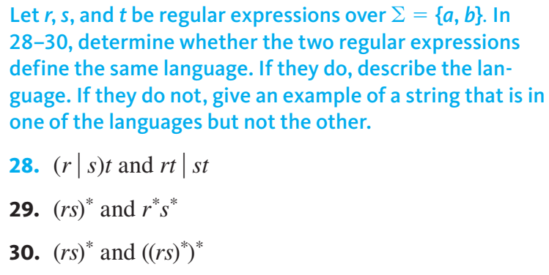

Slide 39
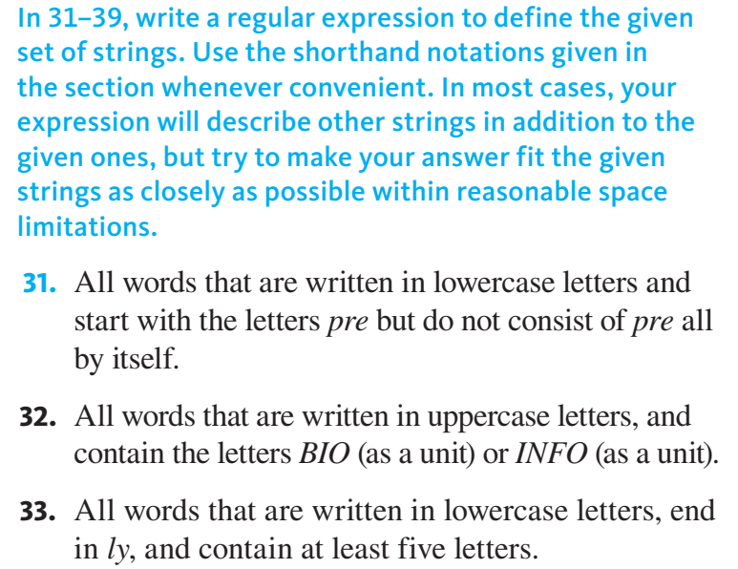

Slide 40
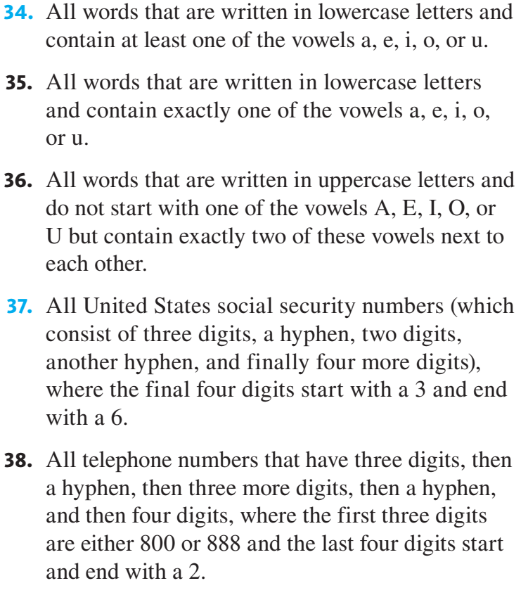

Slide 41
Finite-State Automata

Slide 42
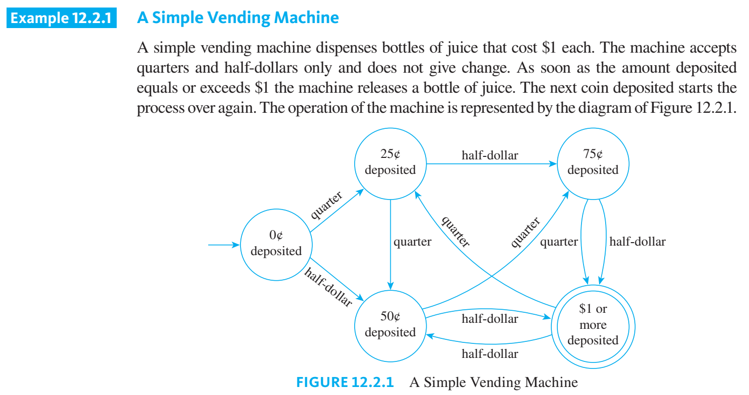

Slide 43
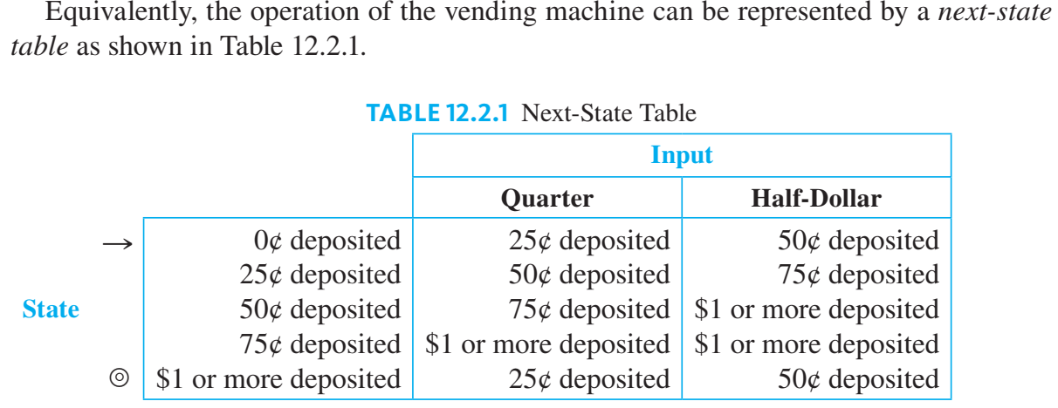

Slide 44
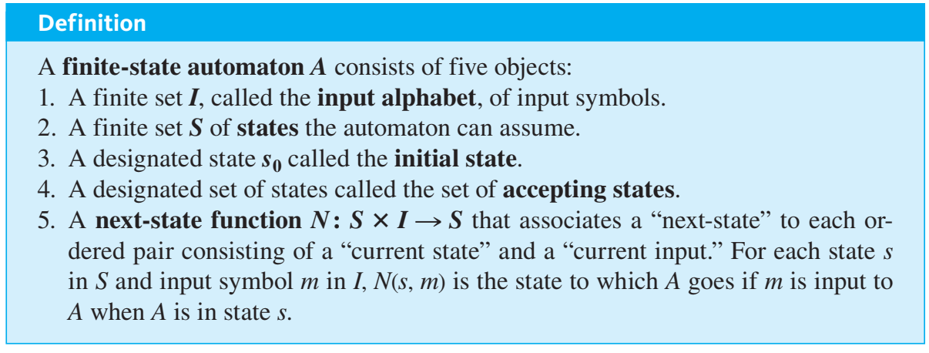
Definition of a Finite-State Automaton

Slide 45
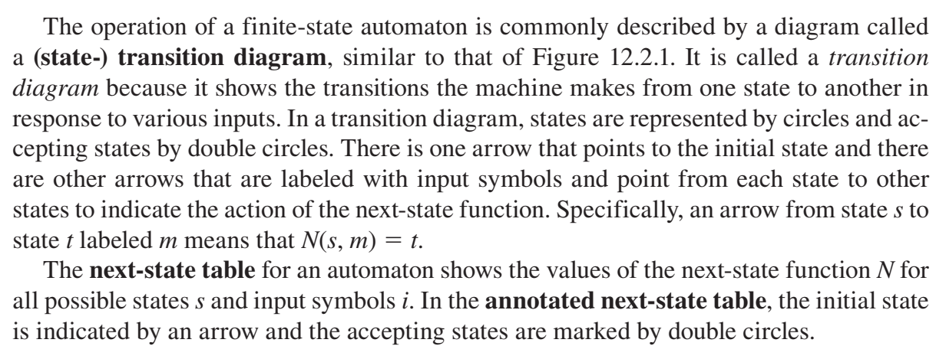

Slide 46
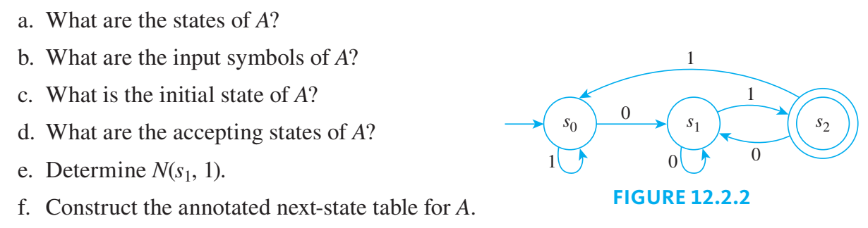

Slide 47
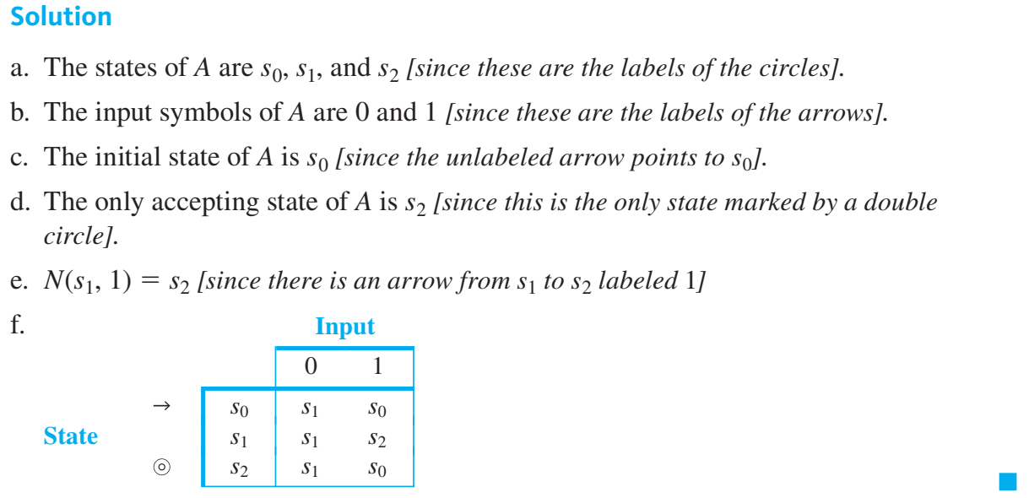

Slide 48
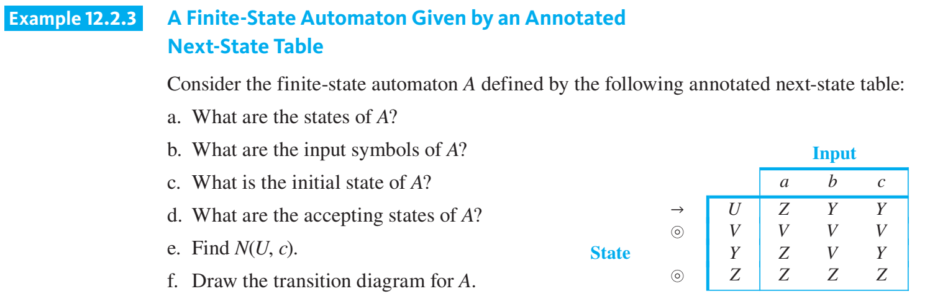

Slide 49
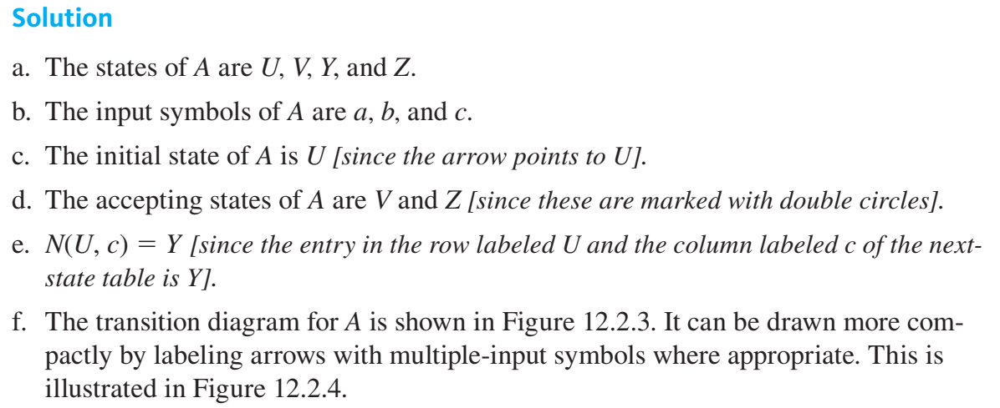

Slide 50
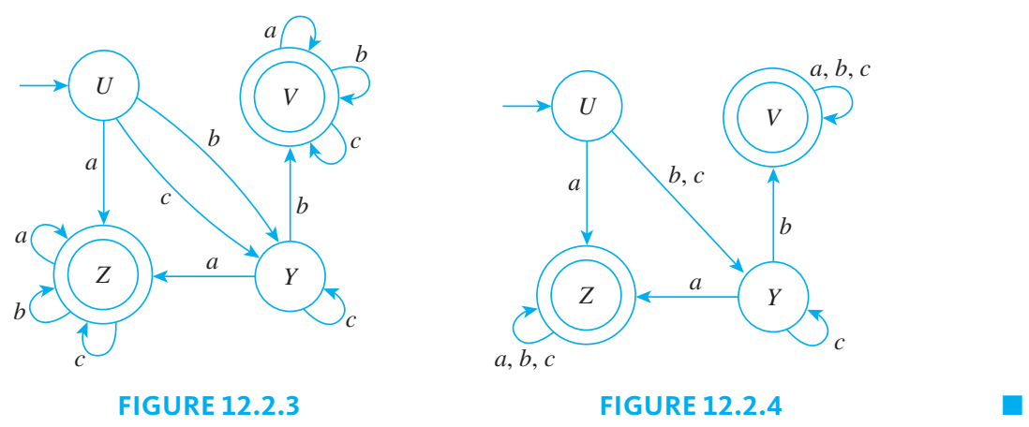

Slide 51
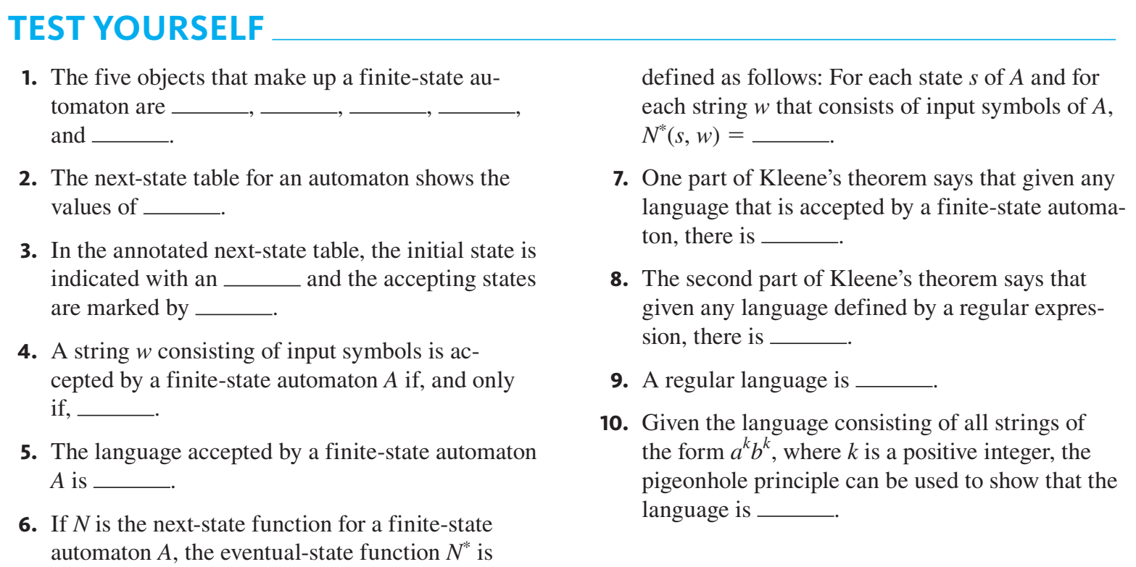

Slide 52
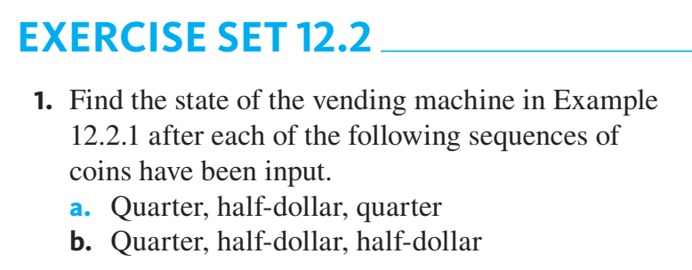


Slide 53
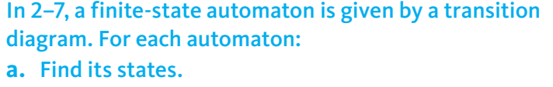
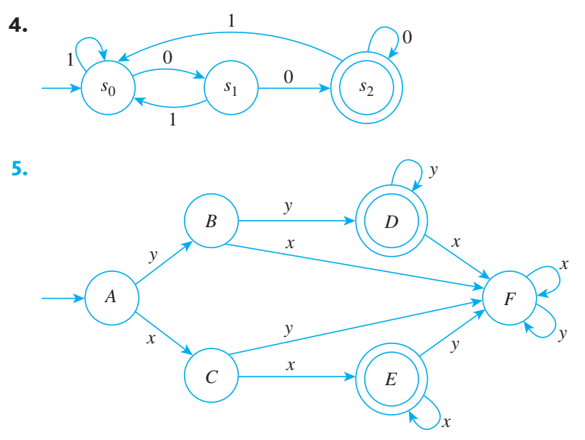


Slide 54




Slide 55
The Language Accepted by an Automaton

Slide 56


Slide 57


Slide 58


Slide 59

The Eventual-State Function
Now suppose a finite-state automaton is in one of its states (not necessarily the initial state) and a string of input symbols is fed into it in sequence. To what state will the automaton eventually go?
The function that gives the answer to this question for every possible combination of input strings and states of the automaton is called the eventual-state function

Slide 60



Slide 61


Slide 62


Slide 63



Slide 64
Designing a Finite-State Automaton

Slide 65


Slide 66

s(k) = the state of a string where the remainder of the number of ‘1’ in s dividing 3 equals to k.

Slide 67


Slide 68


Slide 69


Slide 70


Slide 71


Slide 72


Slide 73


Slide 74
13.1 Languages and Grammars

Slide 75
13.1.1 Introduction
Words in the English language can be combined in various ways.
natural language, that is, a spoken language, such as English, French, German, or Spanish, is extremely complicated
a formal language, which, unlike a natural language, is specified by a well-defined set of rules of syntax

Slide 76


13.1.2 Phrase-Structure Grammars

Slide 77



Slide 78



Slide 79


Slide 80


Slide 81


Slide 82


Slide 83
13.1.3 Types of Phrase-Structure Grammars
A type 0 grammar has no restrictions on its productions.
A type 1 grammar can have productions of the form w1 → w2, where w1 = lAr and w2 = lwr, where A is a nonterminal symbol, l and r are strings of zero or more terminal or nonterminal symbols, and w is a nonempty string of terminal or nonterminal symbols. It can also have the production S → 𝜆 as long as S does not appear on the right-hand side of any other production.
A type 2 grammar can have productions only of the form w1 → w2, where w1 is a single symbol that is not a terminal symbol
type 3 grammar can have productions only of the form w1 → w2 with w1 = A and either w2 = aB or w2 = a, where A and B are nonterminal symbols and a is a terminal symbol, or with w1 = S and w2 = 𝜆

Slide 84
13.1.3 Types of Phrase-Structure Grammars
Type 2 grammars are called context-free grammars because a nonterminal symbol that is the left side of a production can be replaced in a string whenever it occurs, no matter what else is in the string.
A language generated by a type 2 grammar is called a context-free language.
When there is a production of the form lw1r → lw2r (but not of the form w1 → w2), the grammar is called type 1 or context-sensitive because w1 can be replaced by w2 only when it is surrounded by the strings l and r.
A language generated by a type 1 grammar is called a context-sensitive language.
Type 3 grammars are also called regular grammars. A language generated by a regular grammar is called regular.

Slide 86



Slide 87




Slide 88



